Slide 1
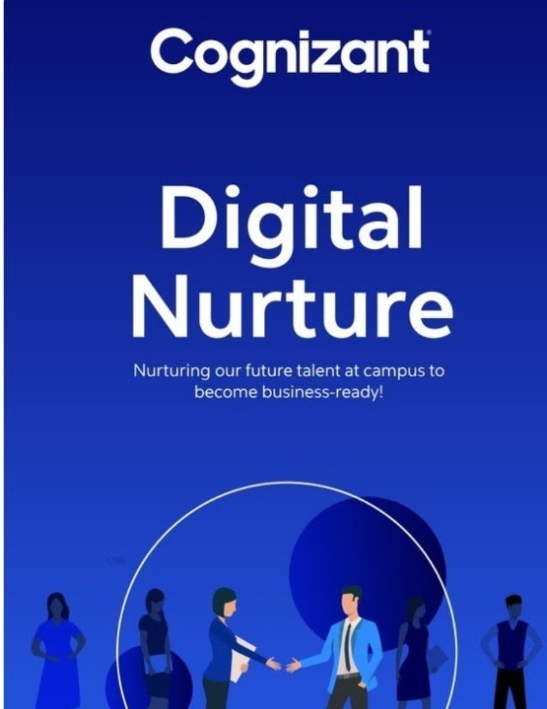
Basic Details and Problem Statement
Cognizant
digital nurture
Problem Statement Title: Connected experiences for consumers
Team Name: m-cos
Institute Name: VIT BHOPAL University

Slide 2
Idea/Approach Details
Our App name m-cos help users to feel connected with brands products using unique features of our app.
m-cos can help customers to take a trial of the product in Real-Time with the help of Augmented Reality Technology.
m-cos provides personalized experience to users according to their regular shopping & the loyalty points
Some amazing features including server based WhatsApp chatbot, user-friendly layout.
Technology stack
Front end:-
XML for Front End
Back end:-
Java for Back End
Computer Vision (CV) for AR technology
Firebase Database

Slide 3
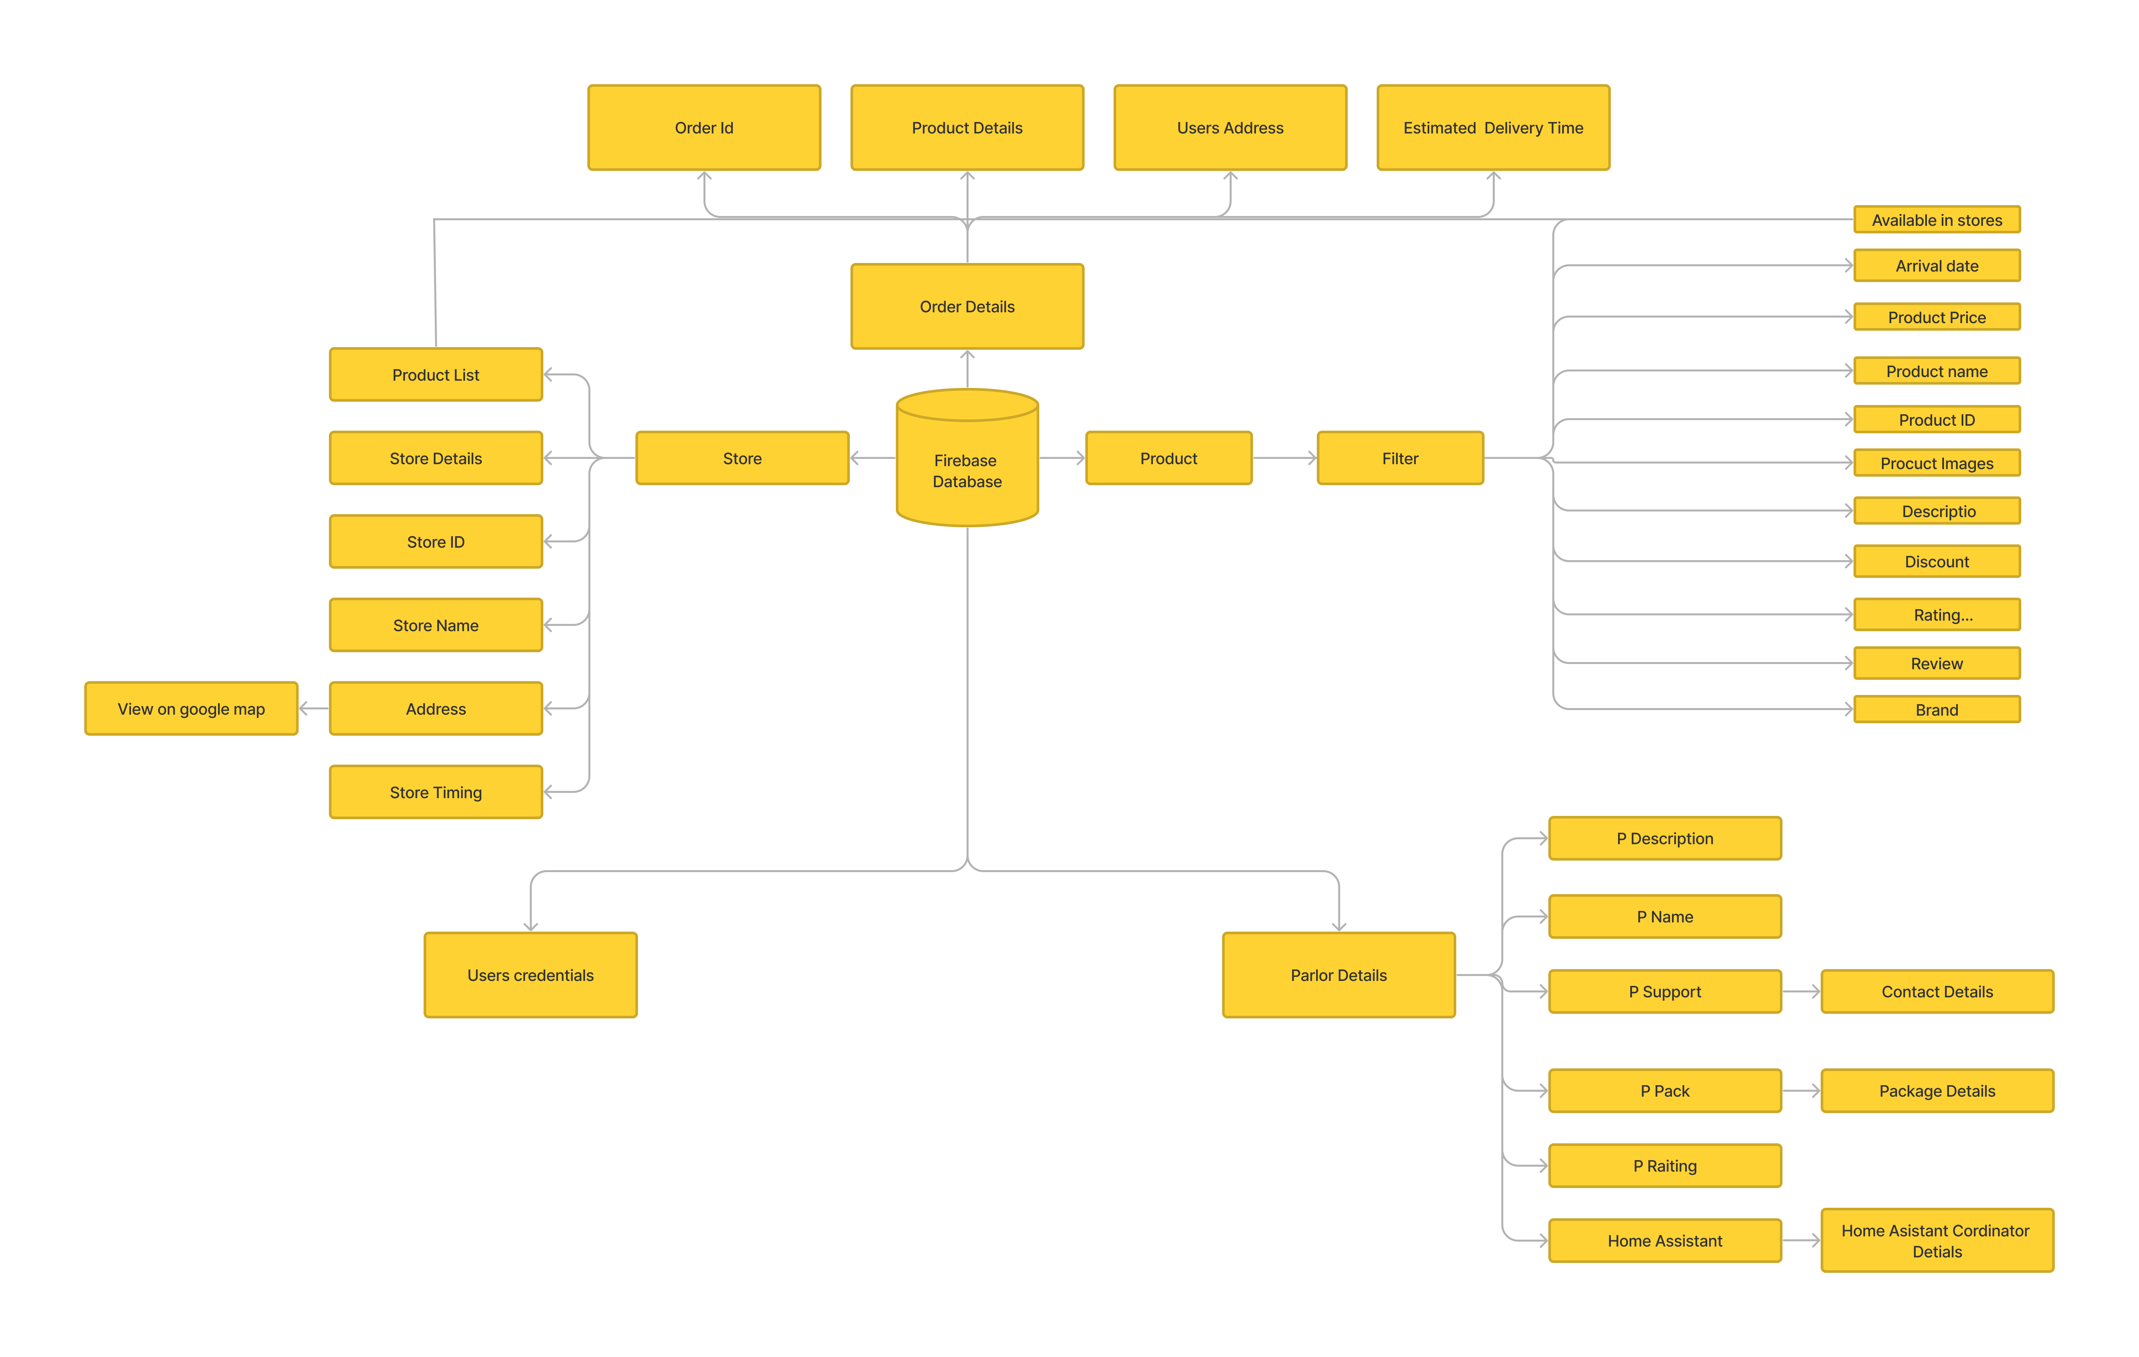
Architecture Diagram
Flow-Diagram

Slide 4
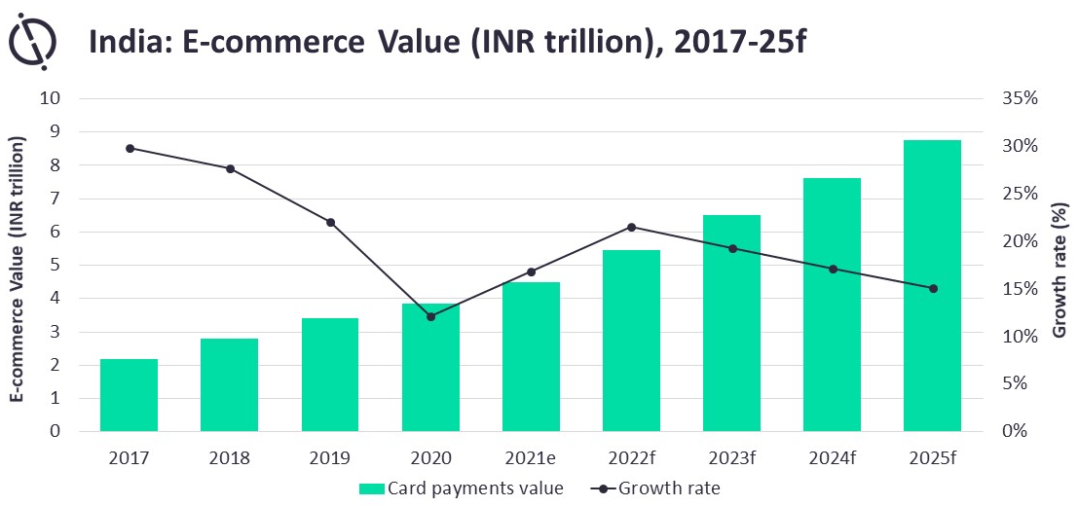
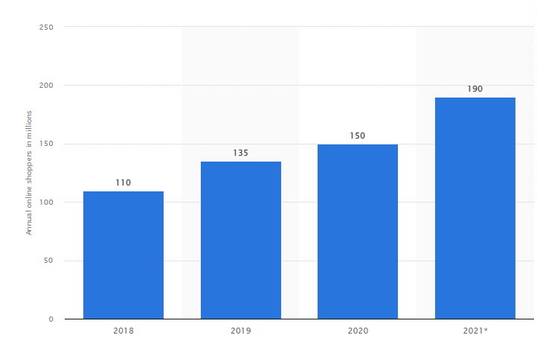
Statistics Regarding Ecommerce

Slide 5
THANK YOU!

